Slide 1
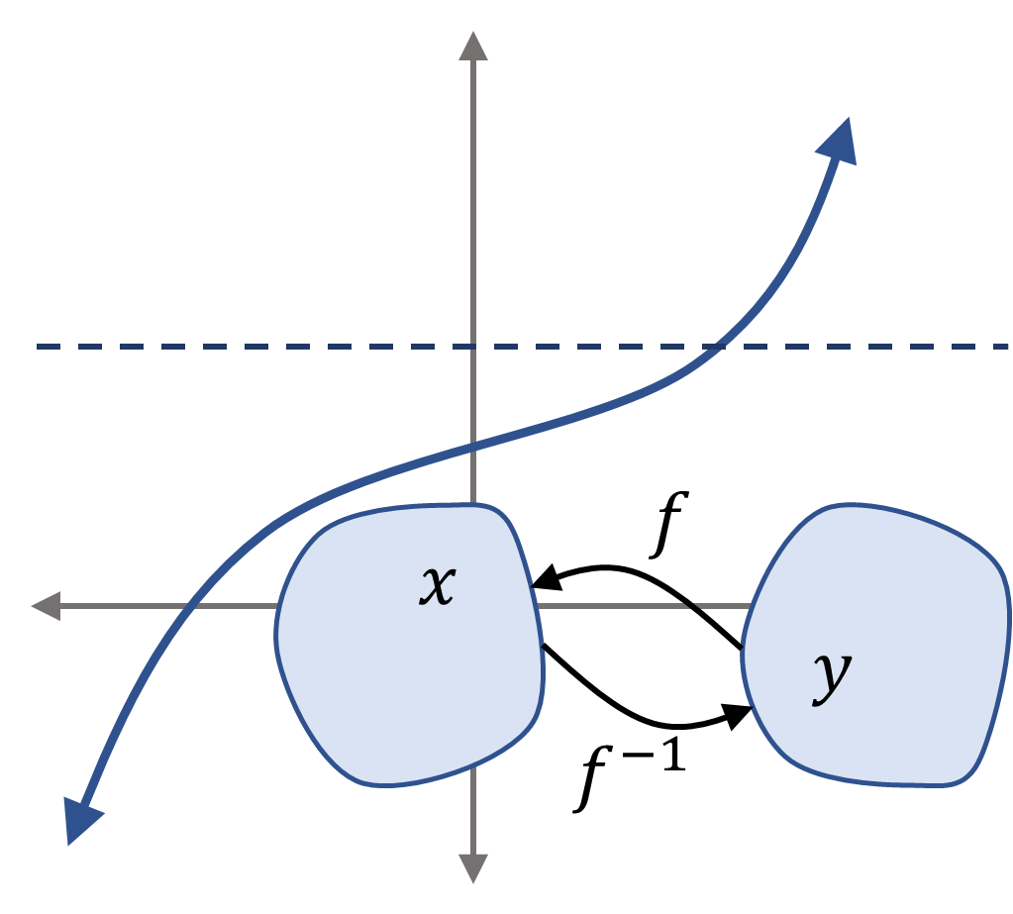




$$f$$
$$x$$
$$y$$
$$f^{−1}$$

Slide 3




$$f$$
$$x$$
$$y$$
$$f^{−1}$$

Slide 4


$$f$$
$$f^{−1}$$

